Slide 1
Regional climate and its variability over the Hindu-Kush Himalayas: Users’ perspective
Arun Bhakta Shrestha

Slide 2

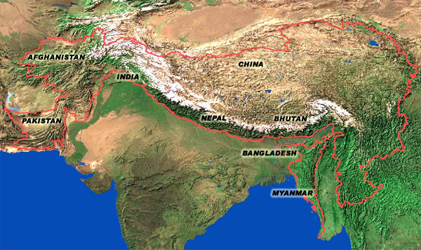








Introduction
ICIMOD

Slide 3
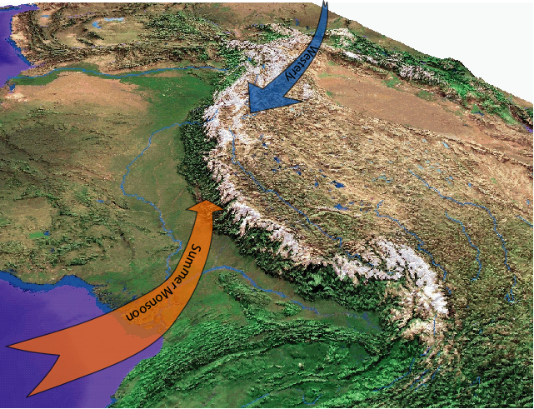
The “Third Pole”
Largest reserve of snow and ice outside the polar regions

Slide 4
The “water tower”
Amu Darya
Indus
Ganges
Brahmaputra (Yarlungtsanpo)
Irrawaddy
Salween (Nu)
Mekong (Lancang)
Yangtse (Jinsha)
Yellow River (Huanghe)
Tarim (Dayan)
These River Basins provide services to 1.3 billion people, a fifth of the world’s population (ICIMOD, 2009)

Slide 5
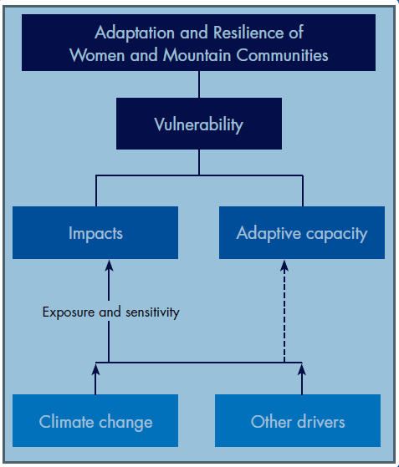
HICAP Goal and framework
Contribute to enhanced resilience to change, particularly climate change, through improved understanding of vulnerabilities, opportunities and potentials for adaptation, and the development of strategies and policies based on scientific/evidence-based knowledge in the HKH.

Slide 6
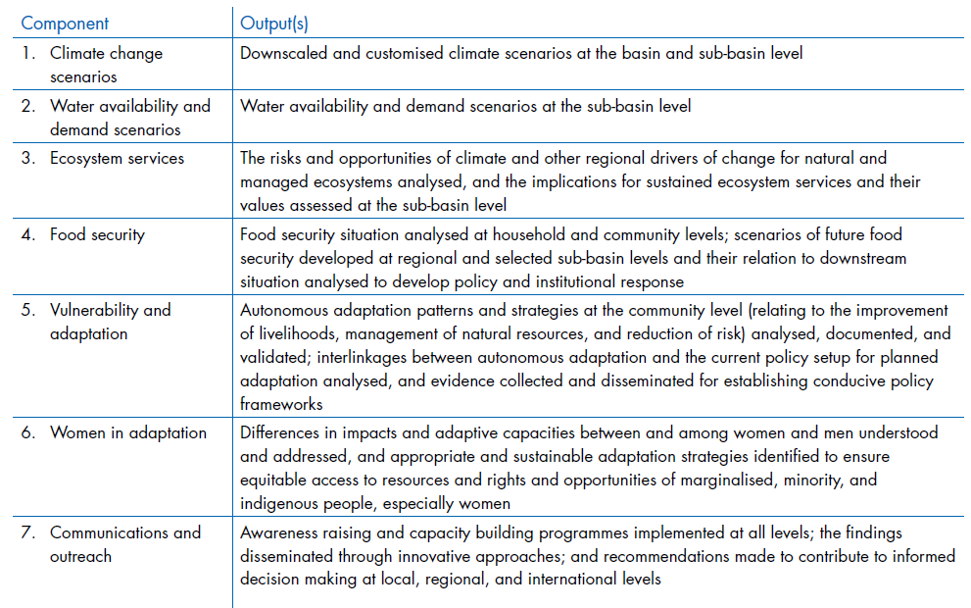
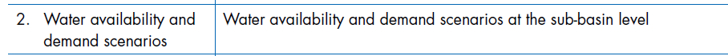
HICAP Components
Historical climate trends and variability
Downscaled and customised climate scenarios

Slide 7
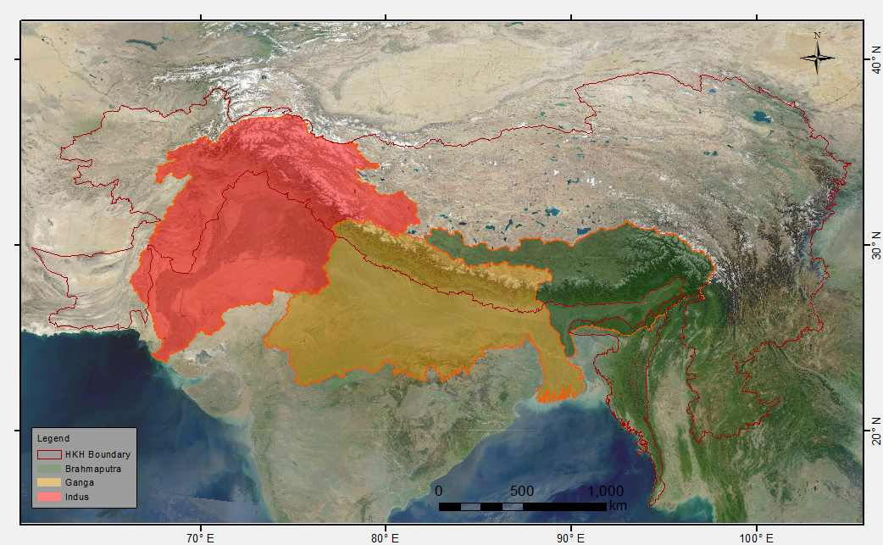
Analysis of Historical data
Precipitation: APHRODITE
Temperature: Princeton

Slide 8
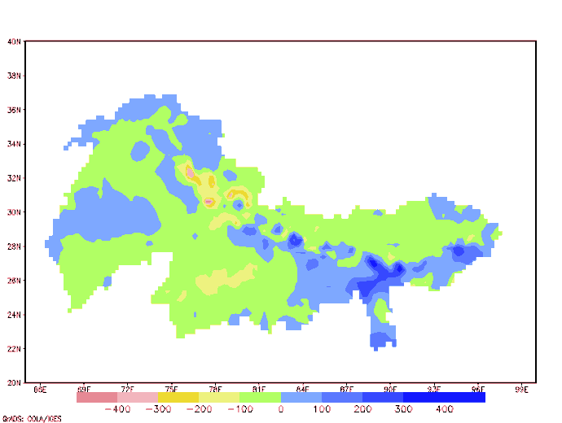
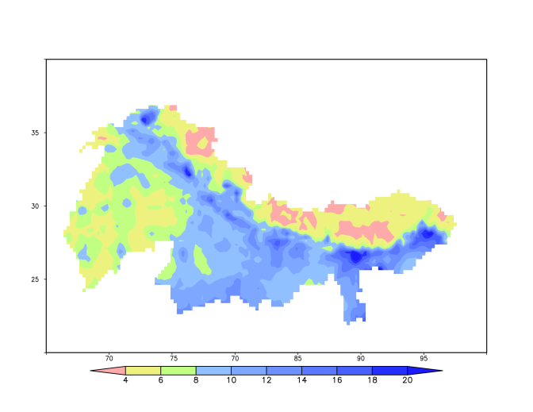
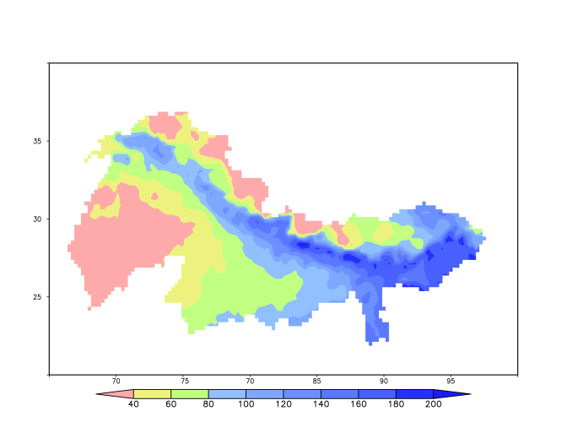
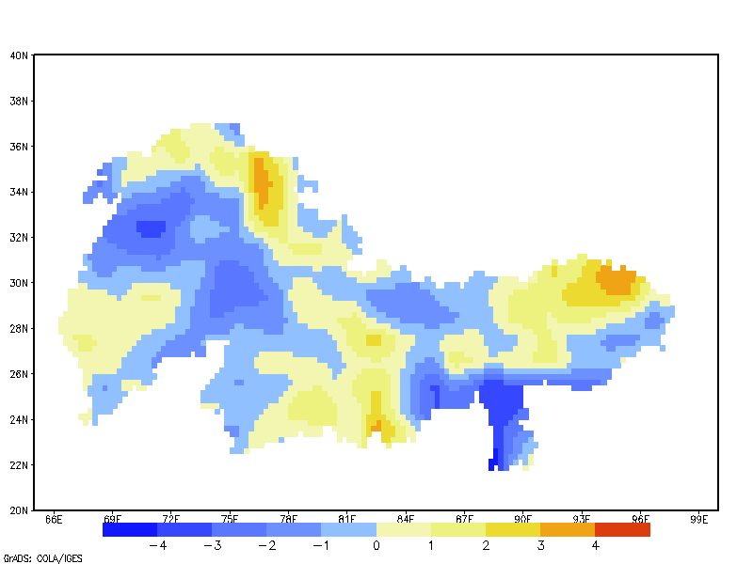
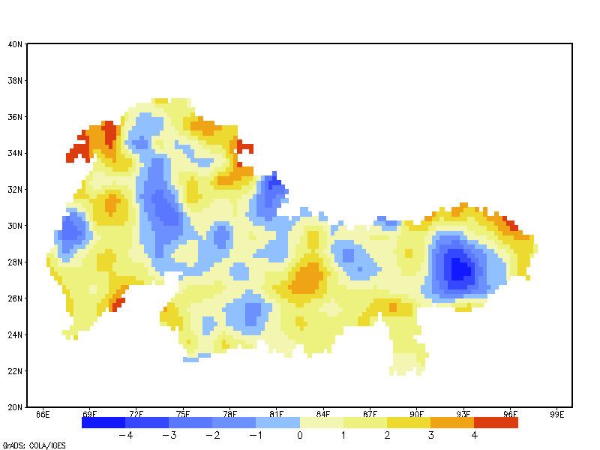
Type of Analyses
Rainfall change
Rainfall intensity (mm/d)
No of rainy days
Summer max temp change
Winter min temp change

Slide 9
Type of Analyses
Basin level analysis
Upper/lower basin analysis
Sub-basin analysis
Clim-Index analysis

Slide 10
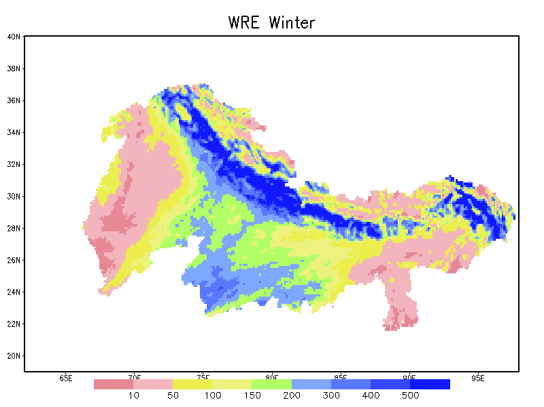
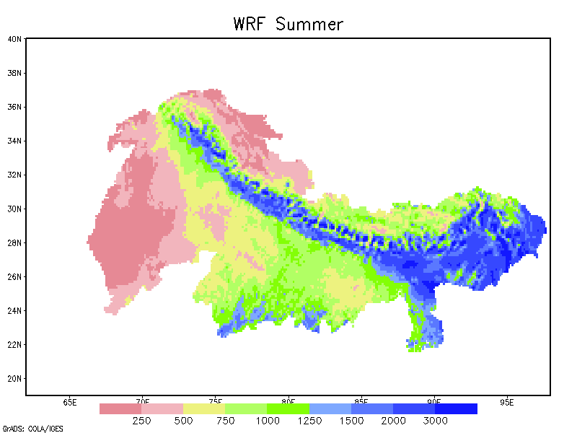
Climate scenario development
WRF downscaling of NorESM data
BCCR
RCP 4.5 and 8.5
2010-2050
12 km spatial resolution
T and P

Slide 11
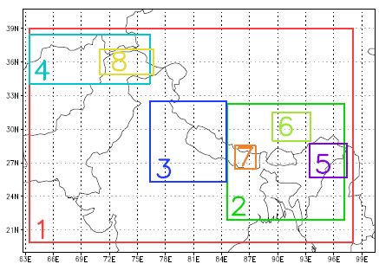
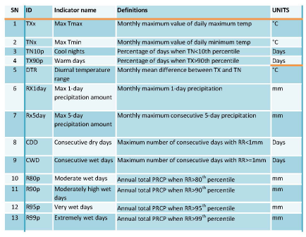
ClimIndex analysis

Slide 12
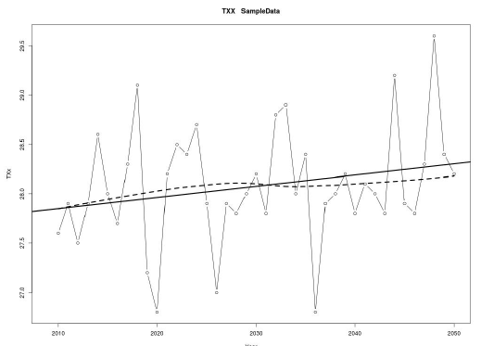
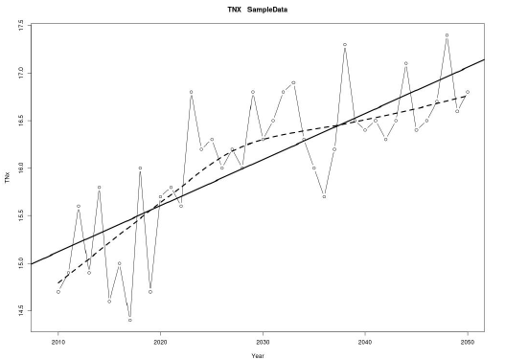
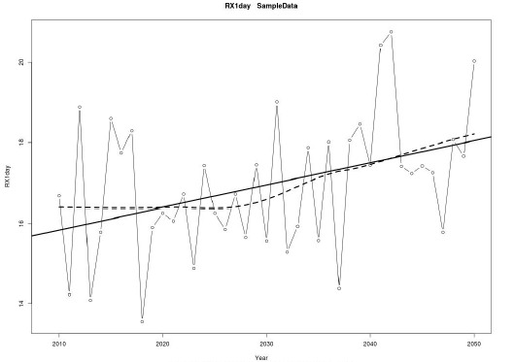
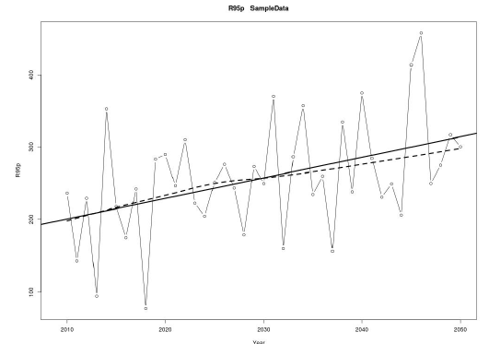
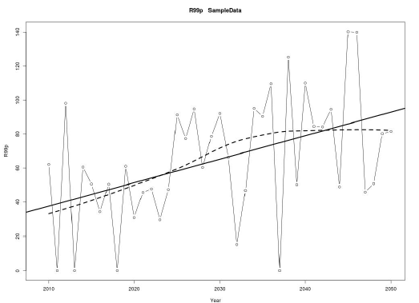
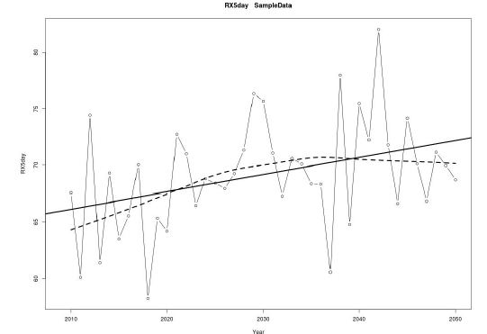
Some results
TXX
TNX
RX1day
R95P
R99P
RX5day

Slide 13
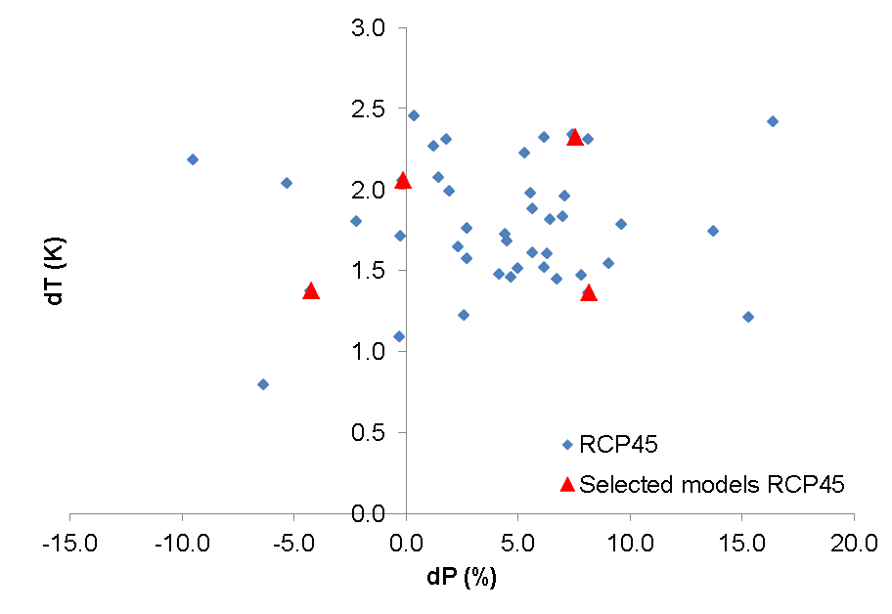
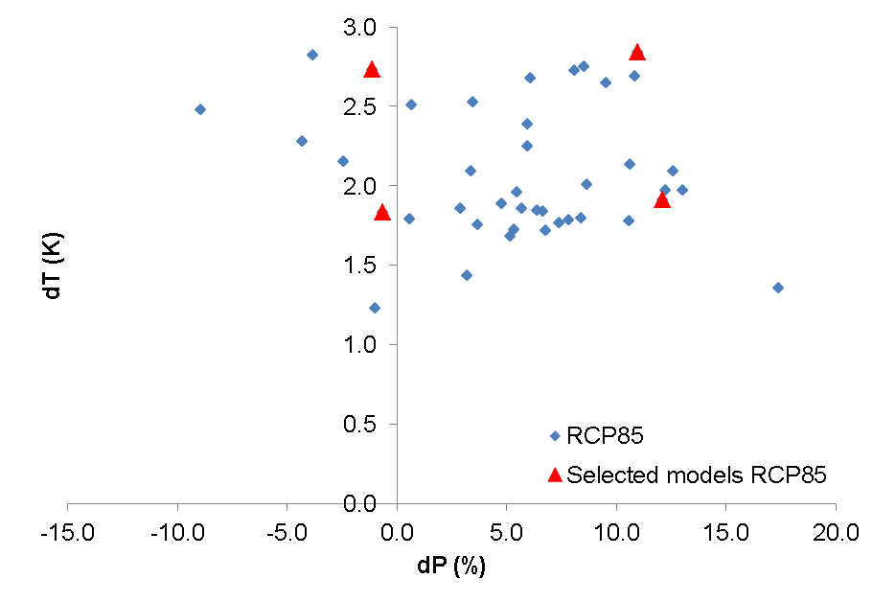
Downscaling of 4 GCM (Δ method)
RCP 4.5
RCP 8.5
Ensemble of models is selected for 4 combinations:
Dry, cold
Dry, warm
Wet, cold
Wet, warm
Selection based on the 10th and 90th percentile values to:
include all 4 corners of the projected changes in temperature and precipitation
avoid including outliers, which can be unreliable

Slide 14
Model selection
Final products are monthly delta change grids for the future relative to a reference period
Reference period 1961-2000
Future period 2021-2050
Delta change grids reflect the change in temperature (K) and precipitation (%) over 60 years
Efficient way to assess climatic changes assuming linear change

Slide 15
Impact on hydrological regime

Slide 16
Approach
High resolution (1 km) fully distributed model for the upstream parts of the Indus, Ganges, Brahmaputra, Salween and Mekong Spatial Processes in Hydrology (HI-SPHY; based on Immerzeel et al. 2010)
Reference period from 1998 until 2007
Forcing and parameterization based on station and remote sensing
Calibration using observed runoff
Climate change scenarios
Ensemble of latest RCM and GCM output
Transient runs until 2050

Slide 17
Spatial extent, time frame and model setup
Hydrological model upstream basins
Upper Salween
103.497 km²
Upper Mekong
77.696 km²
Upper Brahmaputra
372.664 km²
Upper Indus
437.201 km²
Upper Ganges
169.162 km²

Slide 18
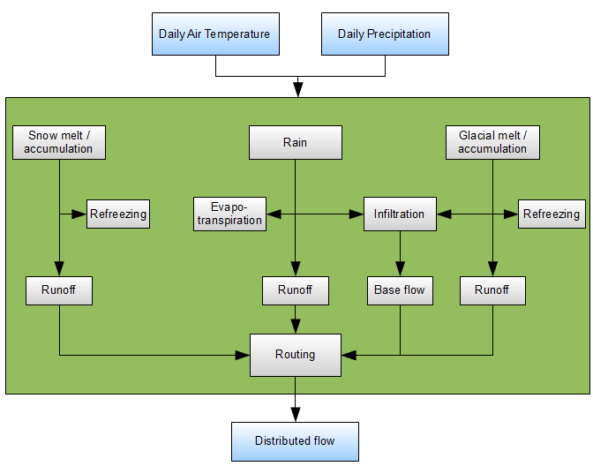
Basin scale model set-up and calibration

Slide 19
Outflow to downstream models

Slide 20
Model input data
Digital Elevation Model (HydroSheds based on NASA SRTM)

Slide 21
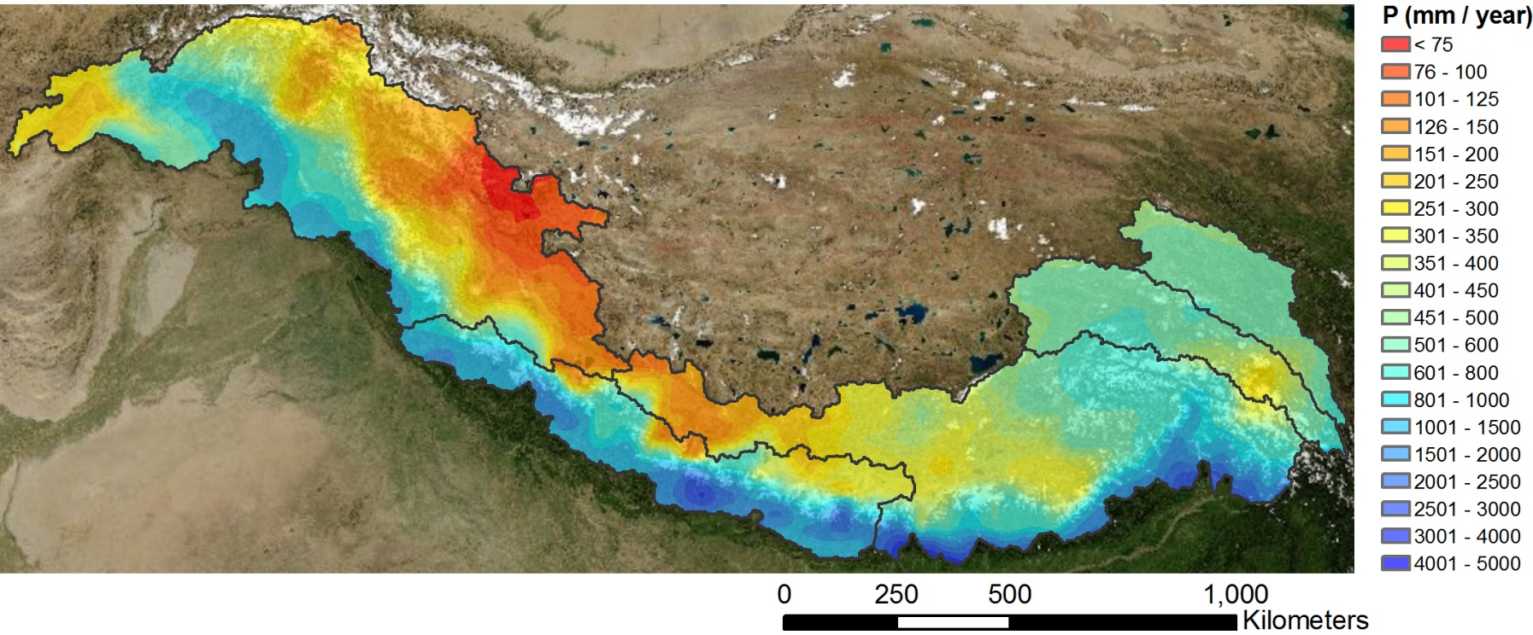
Model input data
Meteorological data
APHRODITE gridded 0.25° daily precipitation 1998-2007
Downscaled to 1 km resolution using a spline interpolation

Slide 22
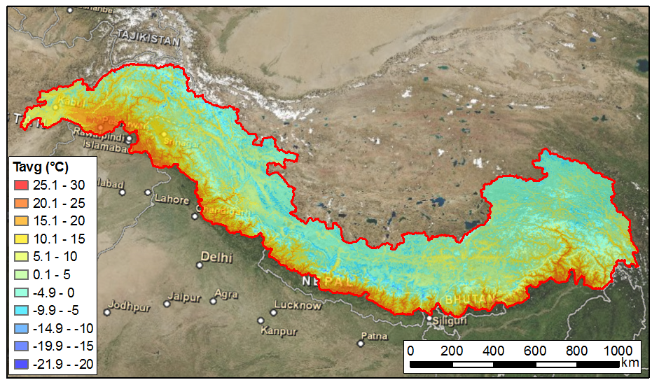
Model input data
Meteorological data
PRINCETON 0. 25° daily average, 0.5 ° daily minimum, maximum temperature
Downscaled to 1 km resolution using DEM and vertical temperature lapse rate

Slide 23
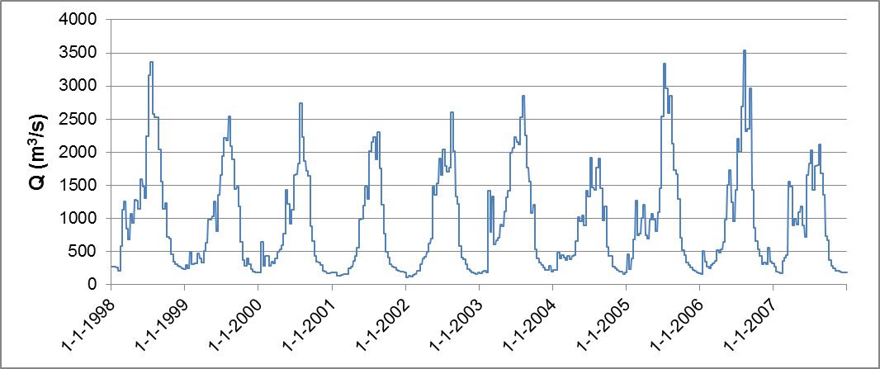
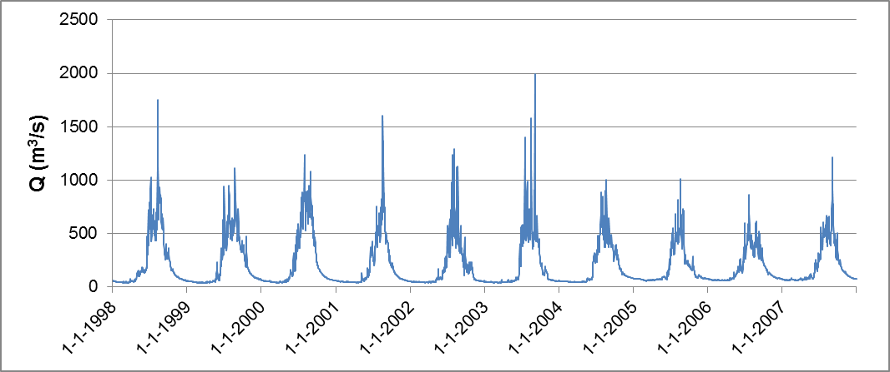
Model input data
River runoff data 1998-2007 for calibration
12 locations with river flow data series (not all complete)

Slide 24
Model input data
Glacier boundaries (inventory ICIMOD, Chinese inventory)

Slide 25
Model input data
Soil map (FAO)

Slide 26
Model input data
Land use map (MERIS GlobCover product)

Slide 27
Climate change scenarios

Slide 28
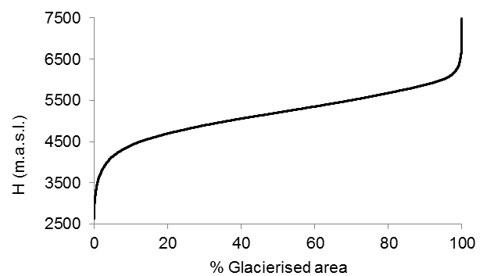
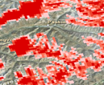
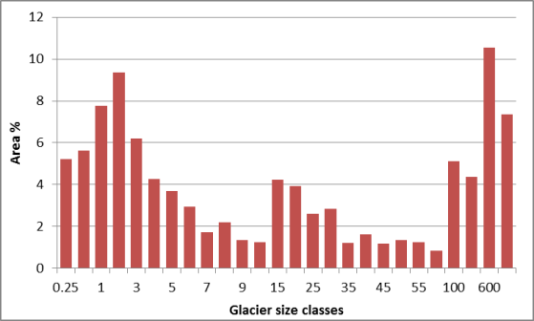
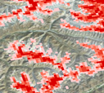
Glacier projections
1 km grid cell scale
Basin-scale
1 km grid cell scale
Glacier
hypsometry
Fractional glacier cover
Glacier mass balance
Volume-Area-scaling
Updated fractional glacier cover per cell
Classification glacier size classes
DEM

Slide 29
Results of hydrological modelling

Slide 30
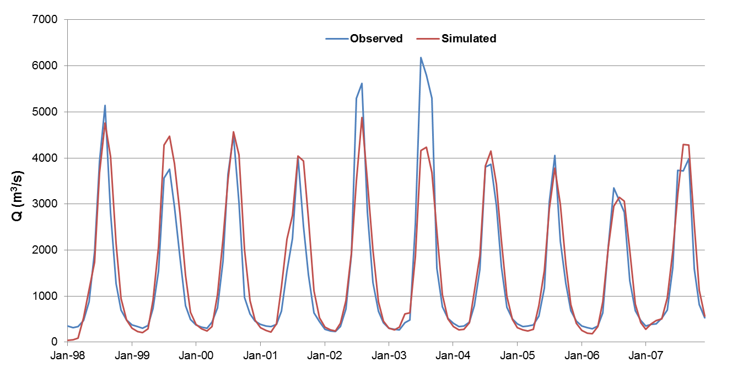
Calibration
Chatara - Saptakoshi River
Pearson | 0.92
Bias | +7.8%
Nash-Sutcliffe | 0.83

Slide 31
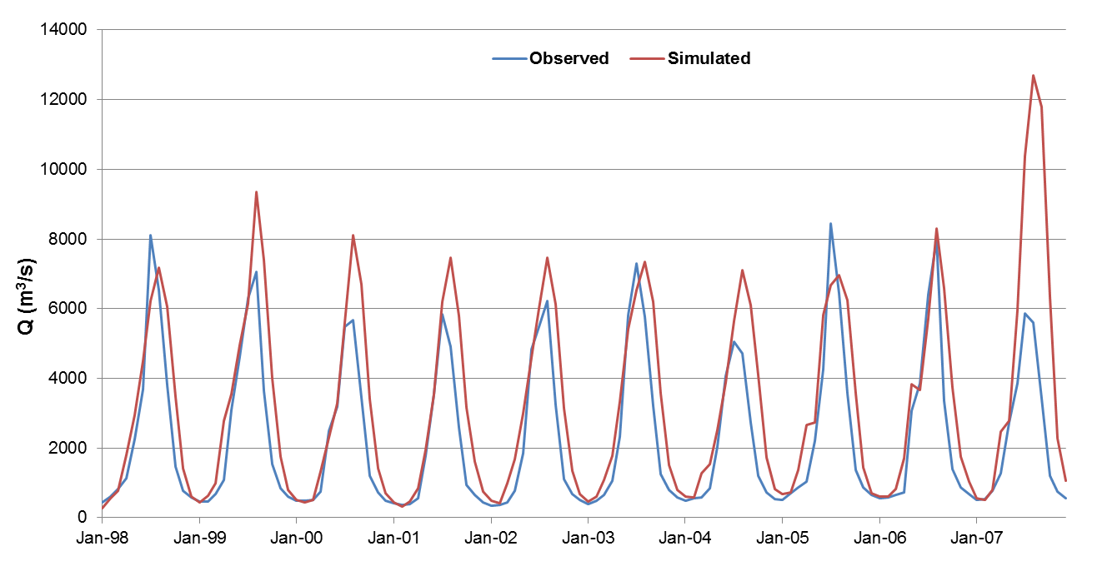
Calibration
2007 error in temperature forcing
Tarbela Inflow - Indus
Pearson | 0.87
Bias | +34.4%
Nash-Sutcliffe | 0.60

Slide 32
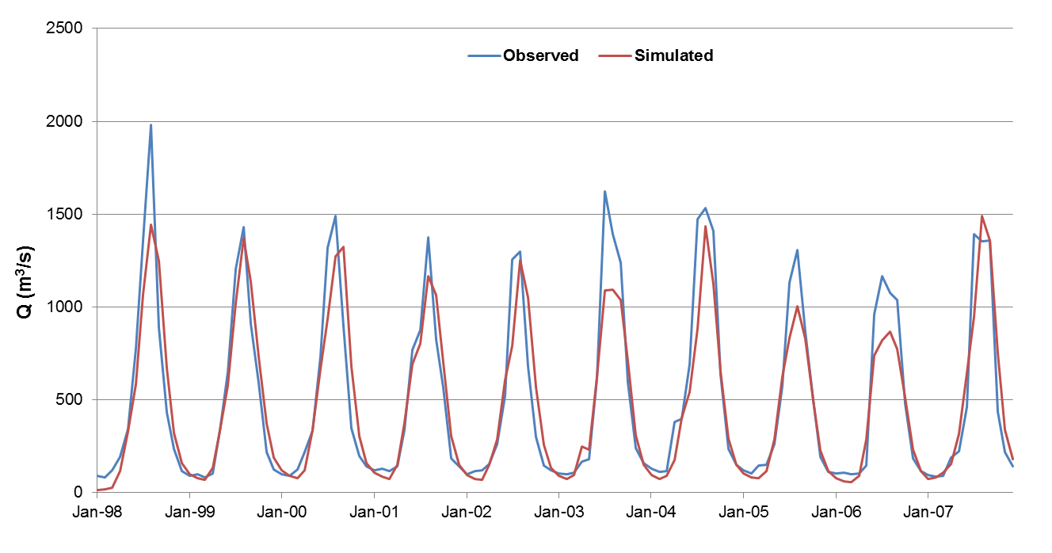
Validation
Pearson | 0.89
Bias | -5.9%
Nash-Sutcliffe | 0.75
Turkeghat - Arun River

Slide 33
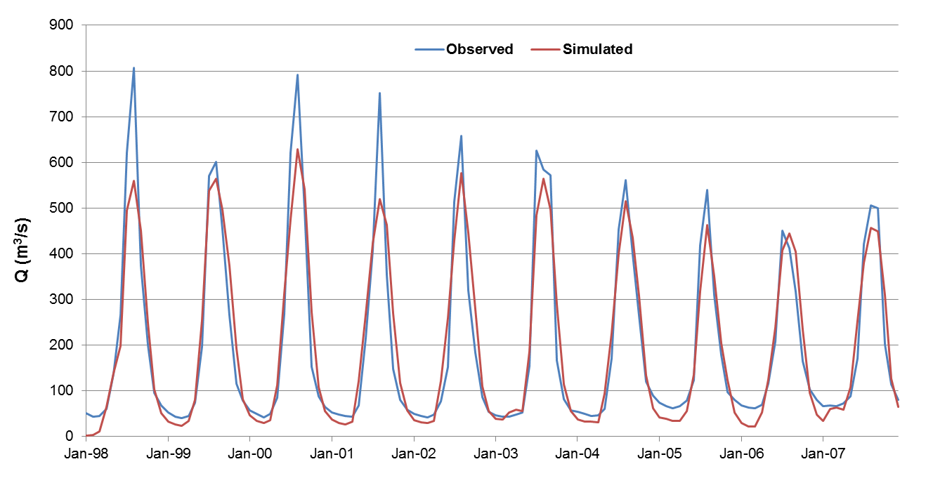
Validation
Pachuwarghat - Sunkoshi River
Pearson | 0.88
Bias | -1.7%
Nash-Sutcliffe | 0.76

Slide 34
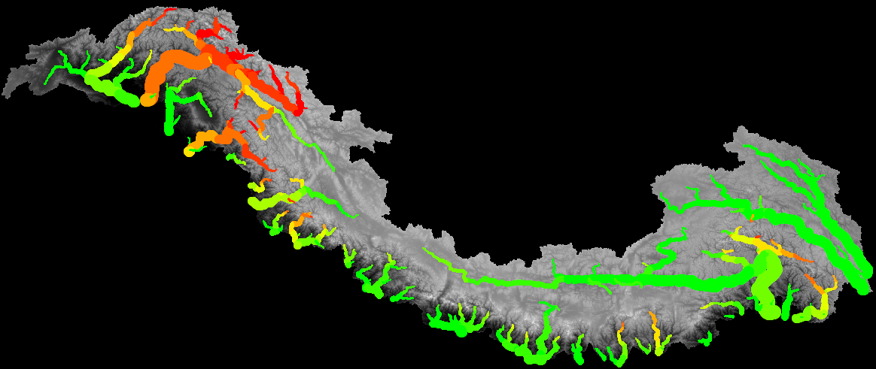
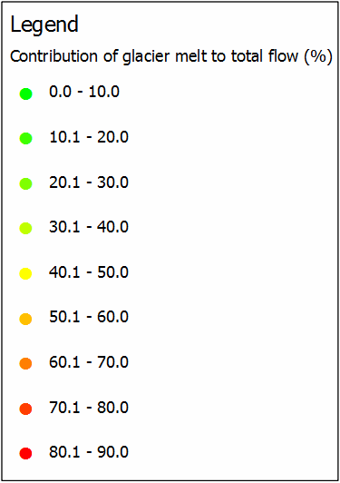
Runoff Contributions 1998-2007

Slide 35
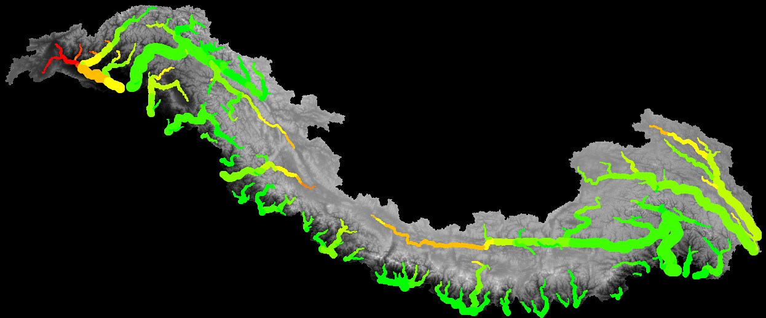
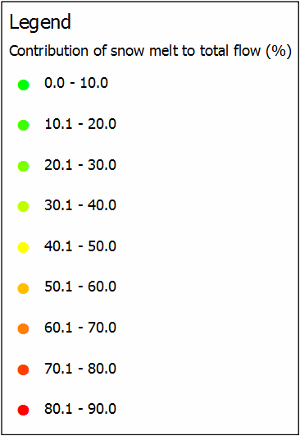
Runoff Contributions 1998-2007

Slide 36
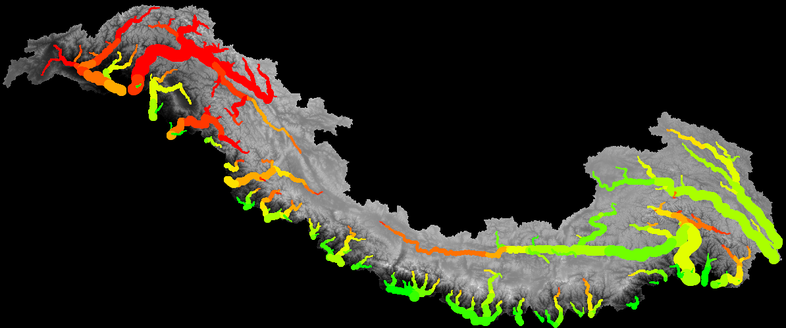
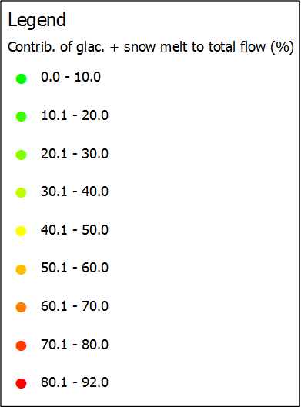
Runoff Contributions 1998-2007

Slide 37
CLIMATE CHANGE IMPACT 2040-2050

Slide 38
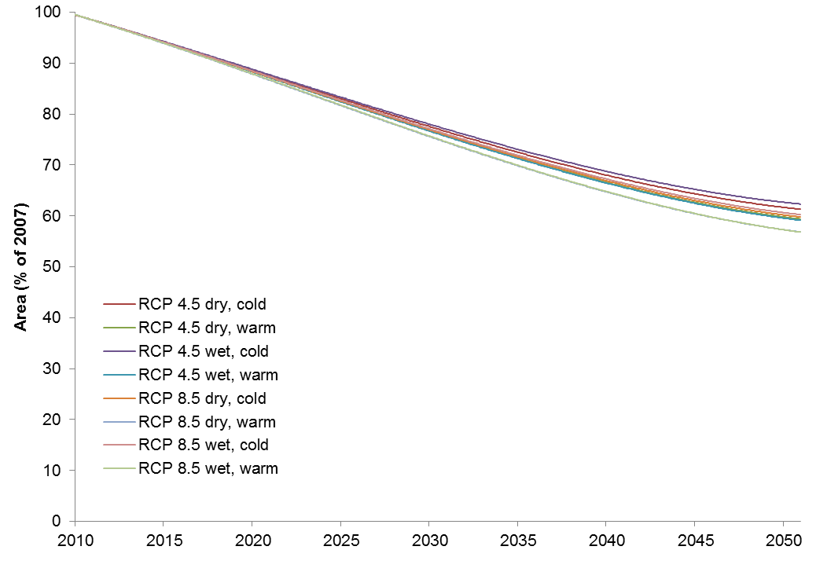
Preliminary changes in glacier extent
Example Upper Indus
Projected decrease glacier extent ~38-44%

Slide 39
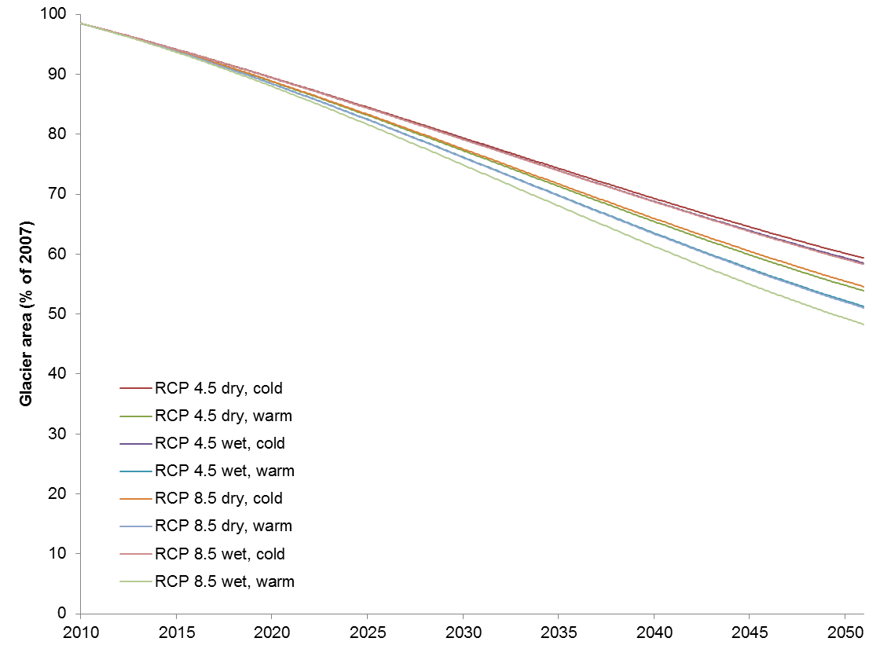
Preliminary changes in glacier extent
Example Upper Ganges
Projected decrease glacier extent ~41-52%

Slide 40
Preliminary changes in glacier extent

Slide 41
Preliminary changes in glacier extent
Glacierised fraction per grid cell (Average 4 GCMs RCP 4.5)

Slide 42
Preliminary changes in glacier extent
Glacierised fraction per grid cell (Average 4 GCMs RCP 8.5)

Slide 44
Preliminary results Dudh koshi & tama koshi

Slide 45
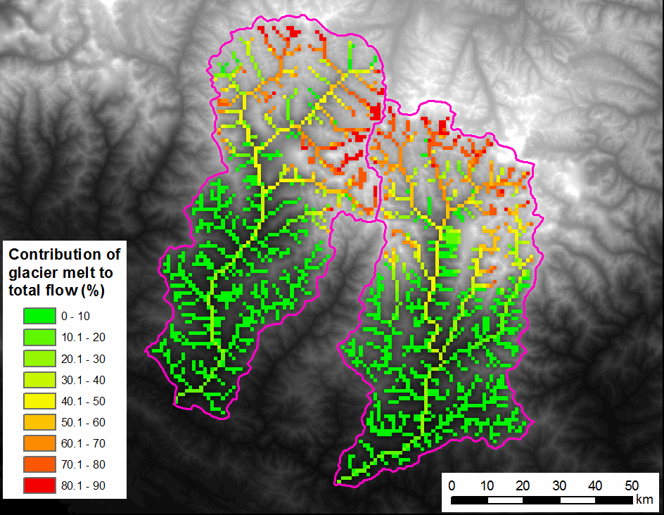
Runoff Contributions 1998-2007

Slide 46
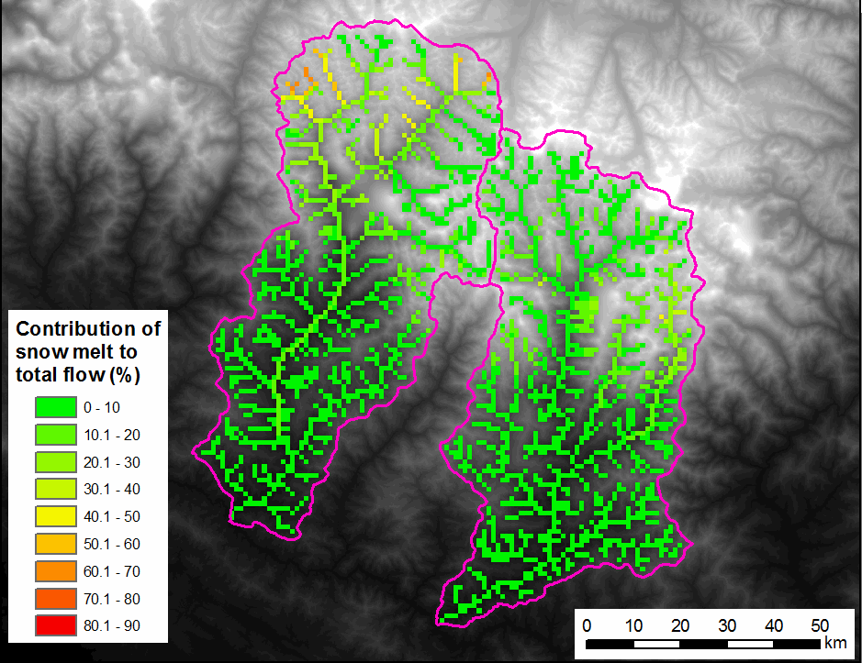
Runoff Contributions 1998-2007

Slide 47
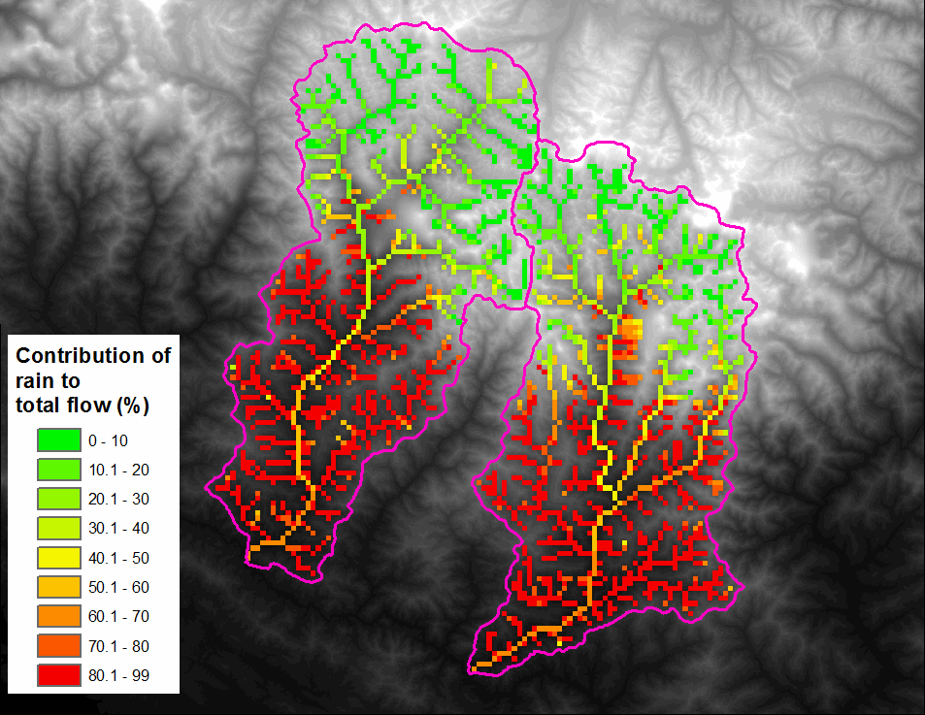
Runoff Contributions 1998-2007

Slide 48
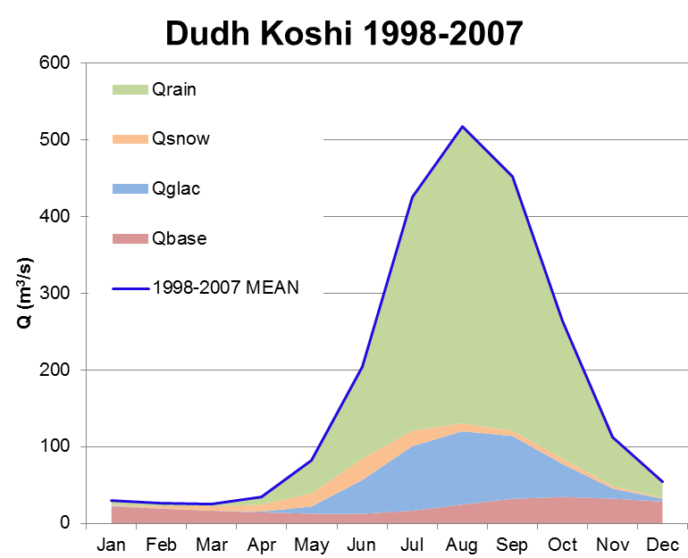
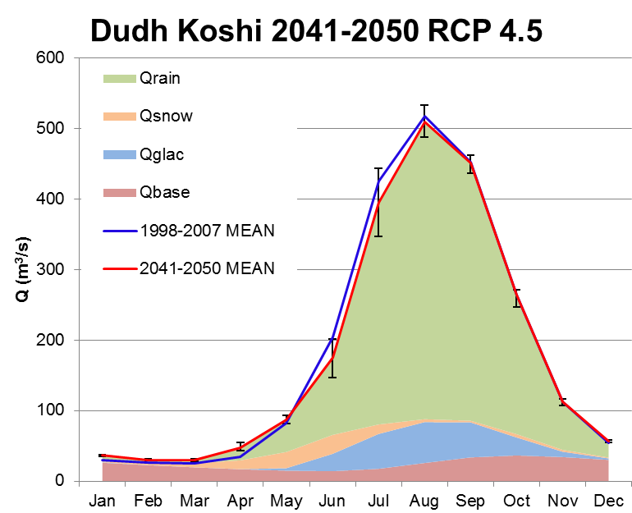
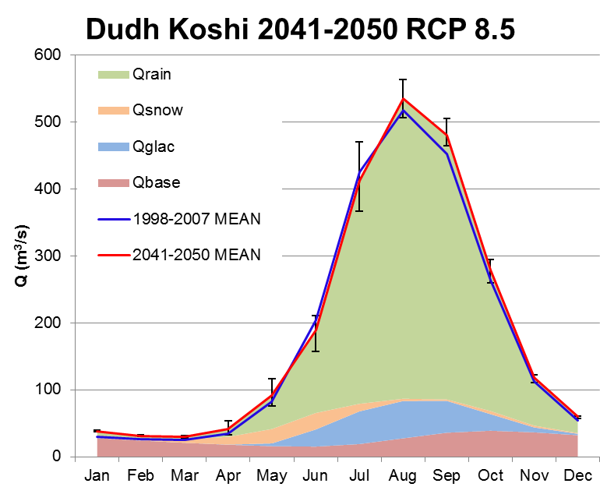
Preliminary changes in stream flow
Dudh Koshi outlet
Little changein total flow 2050
Decreased glacier melt
Increased rainfall-runoff

Slide 49



Preliminary changes in stream flow
Tama Koshi outlet
Little change in total flow 2050
Decreased glacier melt
Increased rainfall-runoff

Slide 50

Flow duration curves

Slide 51

Flow duration curves

Slide 52

Flow duration curves

Slide 53

Flow duration curves

Slide 54
Conclusions
BCCR data has high biases, both in temperature and precipitation resulting in high glacier melt rates
Delta change provide good results; monthly values does not allow extreme event analysis
HI-SPHY can simulate the hydrological regime of upstream basins reasonably well and can provide important insights into the cc impacts
Application of more CORDEX data can enhance the results of HI-SPHY

Slide 55
Acknowledgement
CSIRO
BCCR
Future Water

Slide 56


